Slide 1
Operating Systems

Slide 2
A little history
Early computers
  single user systems
  no keyboards
  no monitors
  manual hardware reconfiguration via switches & patch panels
  evolution
    punched cards
    magnetic tapes
Using a computer meant
  signing up for a time slot
  walking up to the computer center at the appointed time
  sitting in front of a single monitor and working on your program.
  minimum 15-minute slot
    usually spent 10 minutes on
      setting up a machine
      checking configuration
      loading your program
    only 5 minutes or less of actual computation completed
      wasting 2/3 of the time slot
      time = money
http://citeseerx.ist.psu.edu/viewdoc/download?doi=10.1.1.104.1524&rep=rep1&type=pdf

Slide 3
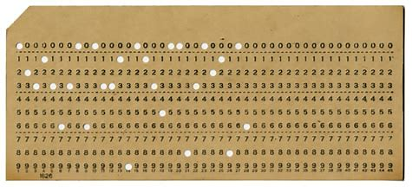
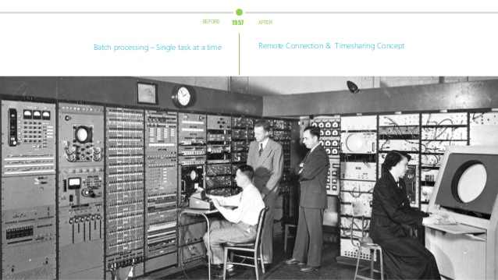
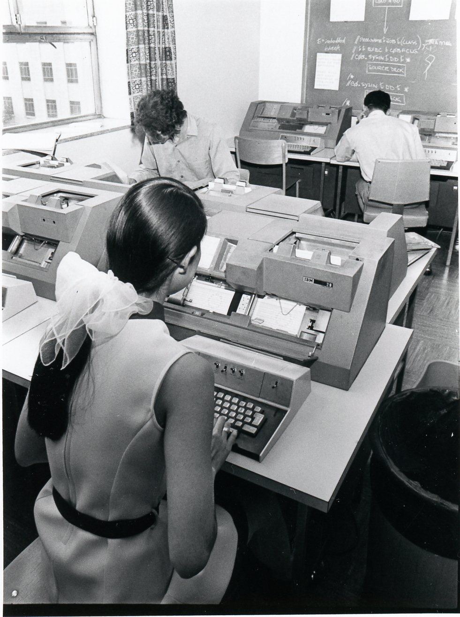
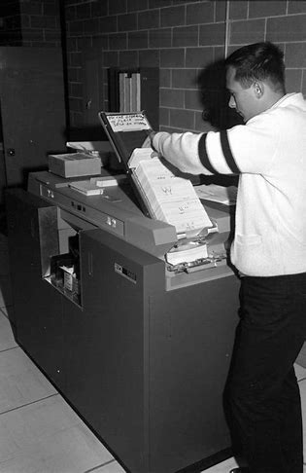
Costs …
The economic cost of all the setup time was staggering.
Companies were charging $300/h for IBM 701 in 1954 = $3,602 in 2025 dollars!
  A lot of time to prepare –> wasted money
  First operating systems -> fixed this problem
    No UI or multitasking
    Maximize hardware utilization
  Automatically load a new program when the currently executing program completed or crashed
"Batch Processing" — automatically load the next program when the current one completes or crashes; maximizes hardware utilization. Still the dominant approach in data processing today.

Slide 4
State of the art … circa 1970s and back again
Timesharing systems
  Parallel sessions!
    Not really – fast switches between processes
  Remote terminals wired to mainframes!
  Command line!
Early real-time systems
  Tiny (often custom) OS’s to run machines ... like the Apollo guidance system!
  Predictability & real real-time
    Not multitasking – one important task
Centralized computing, and all-control to the OS was the approach
  Mainframe
  Not PC

Slide 5
State of the art … circa 1970s and back again
80s -> Personal Computers
  push for simpler (User) Interfaces (vs. interfaces for experts)
  computing became decentralized
  OS is user-centric
    not operator-centric
Today? OS and computing trends are shifting again
  centralization again
    cloud computing
    data centers instead of mainframes
    GPU farms
    PC = terminals
    welcome to the past
  cost - from $0.011/hour to $0.27/hour
https://aws.amazon.com/emr/pricing/

Slide 6
Types of Operating Systems
Whatever the user model, or commercial model, the Operating System drives the capabilities of the computer system.
When OS choice is constrained, the OS capabilities often set boundaries for your application architecture
  you will mostly work with *nix & Windows
  but who knows…
Types of OS architectures
  Monolithic systems
    Everything is in a kernel
  Layered systems
    Hierarchy of functionality
  Microkernels
    Kernel is just a manager

Slide 7
Monolithic
Software
Early computer systems
Basic embedded controllers circa 1980s
Everything is in a kernel
  process management
  memory management
  file system
  I/O drivers
  …
Examples:
  UNIX (classic)
  Linux
  MS-DOS
Architectural Trade-off:
  Pro: Really fast – all functionality 1 call away
  Con: One bug - everything crashes
Kernel

Slide 8
[Semi-]Layered
Theory
Application
Each layer talks to the next layer
‘BIOS’ is in chips, and ‘boots’ the OS
Gains over Monolithic:
  Modifiability — layers are independently replaceable
  Reliability — faults isolated to a layer; less cascade failure
  Maintainability — clear separation of concerns
Tradeoffs
  Performance — cross-layer calls add overhead vs. monolithic
  Pure layering is an architectural ideal; real OSes violate it for performance or legacy reasons
Result → "Semi"-Layered:
  Integrability suffers — special cases punch through layers
  Examples: none exist in pure form
System Programs (resident)
Device Drivers
BIOS
(Basic Input/Ouput Services)

Slide 9
[Semi-]Layered in Practice: DOS
DOS
Deviation from Theory
  DOS targeted single-user, resource-constrained hardware
    Performance mattered more than isolation
  Applications were trusted to behave
    Bypassing layers to call hardware directly was acceptable and fast
    Consequence – any misbehaving application could corrupt the entire system
      Reliability sacrificed for Performance
Architectural ideals are always balanced against real-world constraints
Application
System Programs
(resident)
Device Drivers
BIOS

Slide 10
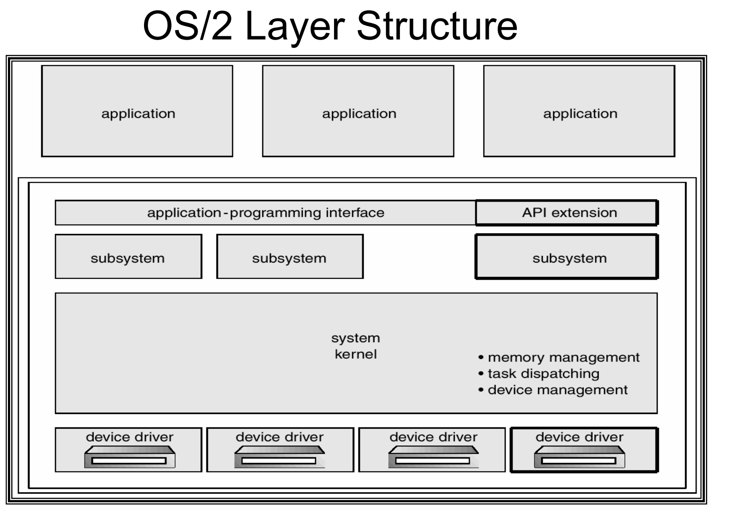
Improved OS Architecture: OS/2
Enforced layers
Architectural Trade-offs
  Pros
    Isolation
    Stability
  Cons
    Integrability
      Lack of applications
      No backward compatibility with DOS/Windows
Outcome
  Death – victim of real-world constraints
Notes:
But why did OS/2 disappear? Lack of applications; no backward compatibility with suite of applications. But was the right direction

Slide 11
Microkernel
Architectural Trade-offs
Pros
  Modifiability — decoupled server processes; update one component without touching others
  Reliability — a crashed driver does not take down the kernel
  Security — minimal attack surface in privileged mode
  Maintainability — small kernel is easier to verify and reason about
  Portability — small kernel is easier to port to new hardware
Cons
  Performance — every service call crosses a user/kernel boundary via IPC; measurably slower than monolithic
  Complexity — coordinating independent server processes is difficult to design and debug
  Pure microkernel is rare in practice — Performance cost too high for general-purpose computing; QNX is the notable exception (automotive, medical devices)
Kernel — only what must run in privileged mode:
  Inter-process communication (IPC)
  Scheduling
  Minimal hardware access
User space — everything else, each as an isolated server process:
  Device drivers
  File system
  Network stack
  …

Slide 12
Types of modern OSes
Linux — monolithic
  Desktop/server (PC), Android, ChromeOS
Windows — evolved from monolithic to hybrid
  95/98/ME — monolithic (and notoriously unreliable)
  NT-family (XP, 7, 10, 11) — hybrid: HAL + kernel + user-mode subsystems organized in layers
macOS / iOS — hybrid (XNU kernel)
  Mach microkernel core + BSD Unix components pulled into kernel space for performance
  Classic example of Performance forcing a compromise on pure microkernel ideals

Slide 13
Kernel Space and User Space …
Problem — early computers
  Run everything in one address space
  Reliability — 1 mistake in 1 program crashes everything
  Security — any process can read or write any other's memory
    e.g. ArtMoney — scans and edits any process's memory (game gold, health, etc.)
Solution — separate trusted and untrusted code
  Kernel space — trusted code (OS, drivers); full HW + memory access
  User space — untrusted code (applications); limited privileges, no HW or kernel access
    Processes can still interfere via shared resources — memory protection alone is not sufficient
Multi-programmed OS With Memory Protection
  Each process – separate virtual address space
    Believes it’s the whole memory
      Starting with address 0
    Translation table: virtual -> real addresses
    10 processes * 4gb = 40gb, physical memory – 8gb
      How? Swap / page file
  Protects processes from each other
    Something crashed? Localized
Dual-mode operation
  CPU switches between kernel and user modes
    Each instruction with a flag to restrict privileges

Slide 14
Address Translation
Virtual
Addresses
Physical
Addresses
Translation Table
Why do you get kernel panic and blue-screens?
Drivers are not perfect
Corrupt somebody’s memory
Translation provides protection
  Processes cannot access other processes' addresses, nor OS addresses
  Reliability (crash isolation), Security (memory isolation)
OS uses physical addresses directly
  No translations needed — kernel runs at full speed
Dual-mode operation enforces the boundary in hardware
  System calls are the only sanctioned crossing point — frequent boundary crossings carry measurable Performance overhead
Virtual Memory
What is swap space?
Notes:
Usually low level drivers corrupt memory that is not meant for their use
OS frees up physical memory by saving memory, state, on HDD. It ‘swaps’ out RAM to disk (e.g. idle applications). If you have a lot of swapping, it will slow down performance

Slide 15
How does an application ‘run’?
Stack
Temporary data - function parameters, return address and local variables
Grows downward into Free Space
Free Space
Heap
Dynamically allocated memory to a process during its run time
Grows upward into Free Space
Data
Global and static variables
Text
Compiled instructions
Process vs. Thread: The above is a PROCESS!

Slide 16
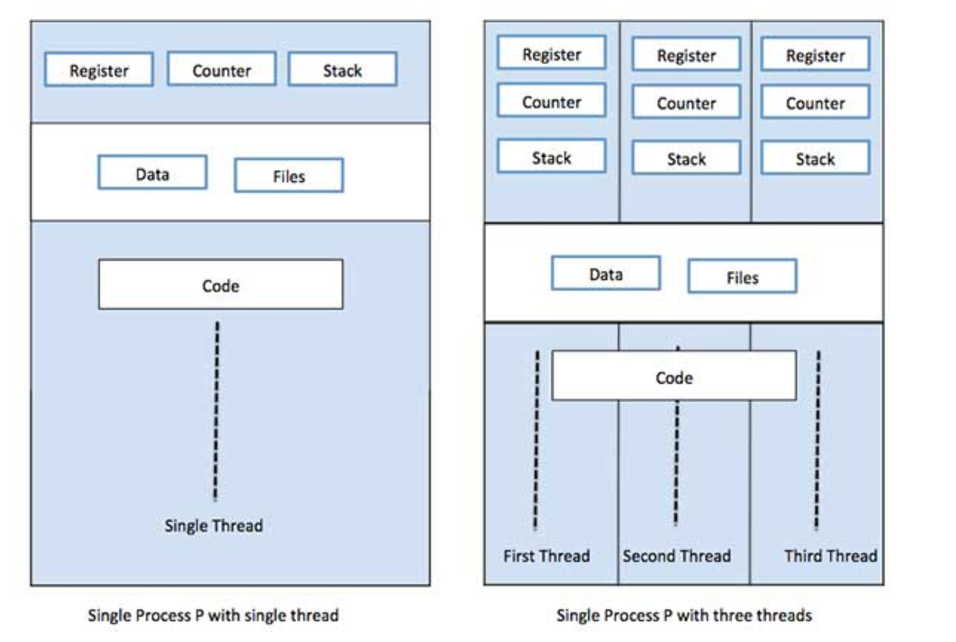
Process vs. Thread
Process | Thread
Process is heavy weight or resource intensive. Creation takes time. | Thread is light weight, taking lesser resources than a process.
Process switching needs interaction with operating system. | Thread switching does not need to interact with operating system.
In multiple processing environments, each process executes the same code but has its own memory and file resources. | All threads can share same set of open files, child processes.
If a process is blocked, you have to wait. | While one thread is blocked and waiting, a second thread in the same task can run.
Multiple processes without using threads use more resources. | Multiple threaded processes use fewer resources.
In multiple processes each process operates independently of the others. | One thread can read, write or change another thread's data. Beware of corruption!
Process
  Has 1+ threads
  Share code / text & data & heap & resources
Notes:
Architectural note: Choice of communication and process/module separation!
https://www.tutorialspoint.com/operating_system/os_quick_guide.htm

Slide 17
Multi-processing
How does an OS run multiple applications?
Co-Operative Multiprocessing
  Each process voluntarily yields
  Oldest (Windows 3.1 and classic Mac OS) - one hung process freezes the entire system
Timesharing scheduling
  OS forces periodic context switches
  Traditional *nix
Priority pre-emptive multi-tasking
  Higher priority tasks interrupt lower priority tasks
  Modern OSes
Address space isolation (see prior slides)
Technically optional — but without it, any process can read or overwrite another's memory, making the system unpredictable and insecure

Slide 18
Co-Operative Multitasking
All processes are memory resident
Running process has full control of CPU
It must explicitly ‘yield’ control to allow another process to run
Drawbacks
  One program can block everything
  Background UI freeze
Process 1
Process 2
Process 3
Executable code segment
Executable code segment
Executable code segment
Yield
Yield
Yield
CPU
e.g. Windows pre-Windows 95

Slide 19
Timesharing Multitasking
Processes are assigned a 'time to run' (sometimes by priority)
OS schedules a time slot for each
Runs each process until time expires
Switches context and runs next priority process
But some animals are more equal, e.g. UI
  How do we build an ‘Orwellian system’?
Process 1
Process 2
Process 3
Process 4
Process 5
OS
CPU
e.g. traditional Unix and early Linux

Slide 20
Priority Preemptive Multitasking
Processes are assigned a priority
OS schedules a time slot for each
Runs each process until time (per priority) expires
Interrupt triggers OS
Switches context (under control of OS) and runs next priority process (pre-empts process, even in the middle of execution)
Run Priority 1
Process 1
Process ID | Priority
1 | 1
2 | 1
3 | 2
4 | 3
5 | 2
Process 2
Run Priority 2
Process 3
Process 5
Run Priority 3
Process 4
OS
CPU
e.g. Modern OSes: Windows, Linux, MacOS

Slide 21
So How Does This Help Us With Architecture Decisions?
Every "historical" aspect in this lecture is really the same handful of tradeoffs
Isolation vs. Performance
  Monolithic vs. Microkernel: everything in one space (fast) vs. isolated services (safe)
  Process vs. Thread: separate memory (safe) vs. shared memory (fast)
Trusting vs. Enforcing
  Cooperative multitasking trusted every process to yield — and that trust is exactly what failed
  Timesharing / preemptive scheduling: OS enforces fairness so no single process can monopolize
Where you'll meet these same decisions again
  Monolithic app vs. microservices = monolithic kernel vs. microkernel, one layer up the stack
  Container/VM isolation choices = "how much do I trust this workload?" all over again
These are tradeoffs you’ll have to weigh as an architect, over and over, at every layer of the stack.

Slide 22
Applying the Tradeoffs to Make a Choice
Requirement: The flight-control computer can never let one faulty driver crash the whole system
  → Choose a microkernel OS.
  A crashed driver stays isolated in its own process instead of taking the kernel down with it. The QNX OS (microkernel), a popular choice in the auto and medical industries, could be a good fit.
Requirement: The point-of-sale terminal must a) require 4MB or less of RAM b) boot one trusted app; and c) run as fast as possible
  → Choose a monolithic OS that bypasses layers for speed.
  With one single trusted app that is resource-constrained (RAM), performance matters more than isolation. Is DOS making a comeback? (Sadly no, probably FreeRTOS)
Requirement: The cloud host must handle workloads from hundreds of unrelated paying customers on shared hardware (multi-tenant)
  → Choose preemptive scheduling, never cooperative.
  You can't trust an arbitrary customer's workload to voluntarily yield the CPU. Just about any modern general-purpose OS is in the running.

